Slide 1
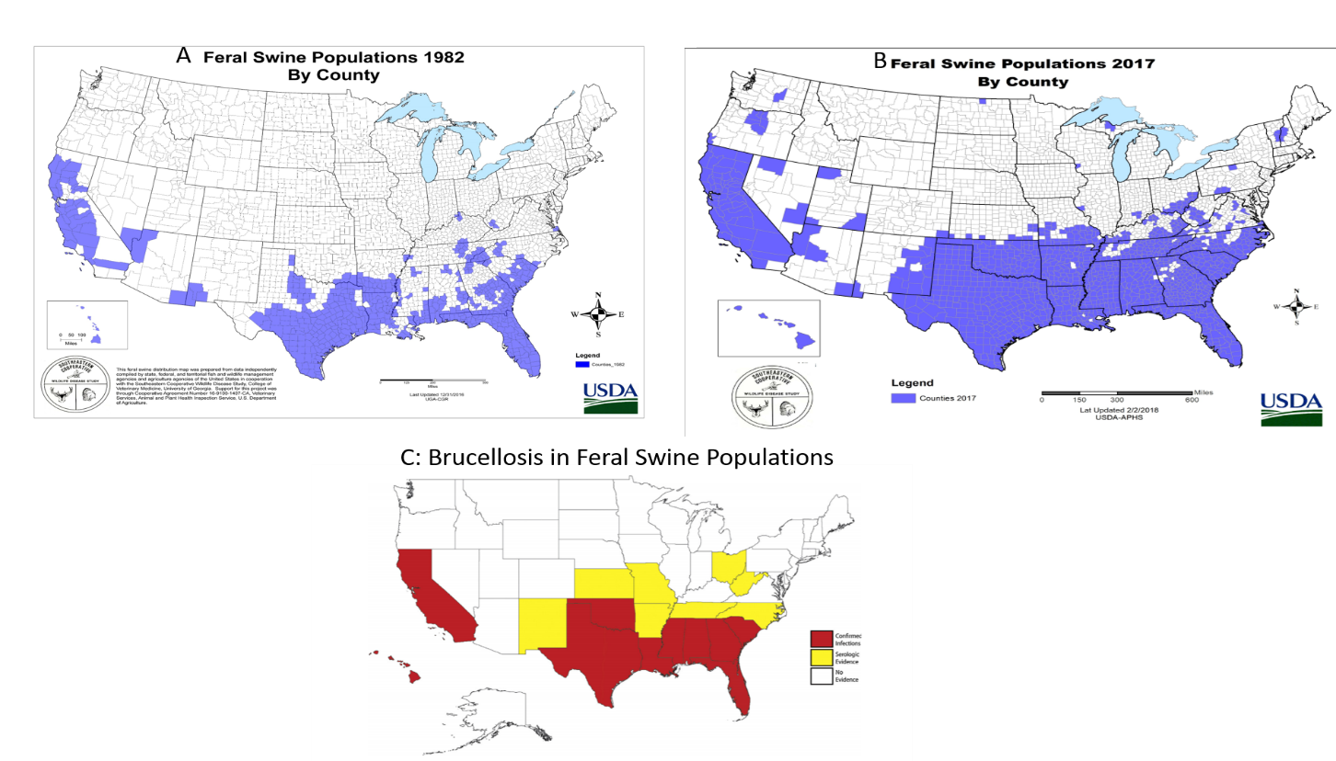
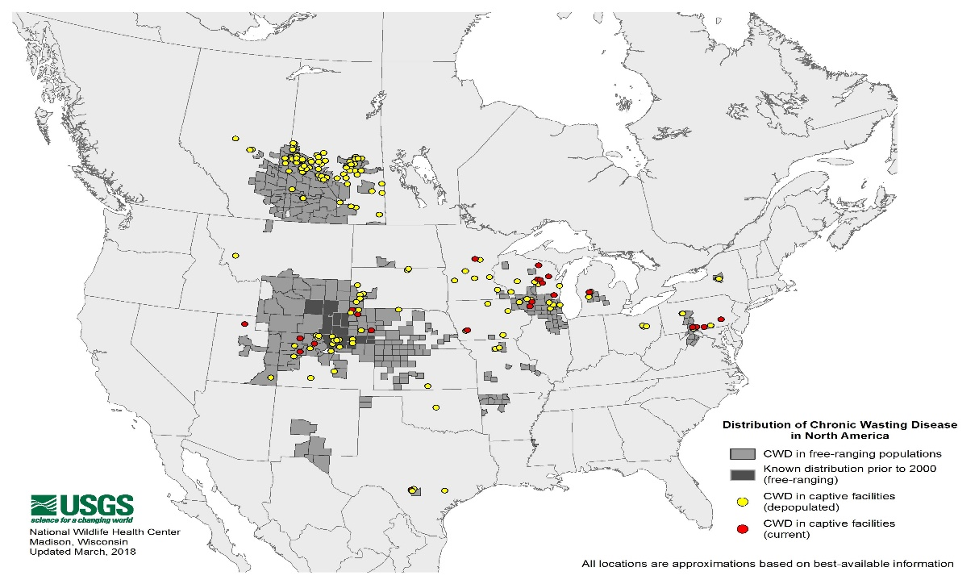
Risk of Brucellosis, Tularemia, and Chronic Wasting Disease in US Hunters: A Systematic Review
Devann Kirkpatrick Department of Epidemiology and Biostatistics, University of Georgia College of Public Health
Introduction
In 2011, 13.7 million people hunted within the US:
11.6 million pursued big game such as deer or elk
4.5 million hunted small game like squirrels or rabbits
2.2 million hunted other game such as raccoons or feral hogs.
Three diseases are highlighted in this systematic review that could potentially put hunters at risk:
brucellosis from feral swine hunting
tularemia from hare hunting
chronic wasting disease (CWD) in cervids that we are currently unsure if it could infect humans.
Results
Conclusions
Brucellosis may become more of an issue as both feral swine populations and brucellosis in feral swine spread.
Though tularemia is a notifiable disease, data on how a case became infected is unavailable.
Furthermore, there is no data on how prevalent tularemia is in animals, making it difficult to estimate the total risk of contact with an infected animal.
CWD is increasing exponentially and it is likely the distribution is larger than we think it is.
Though there has been no definitive proof that humans can become infected by CWD, there has been considerable proof that CWD has distinct strains with varying characteristics and tends to have altered host range upon infection of new hosts unlike other prion diseases.
he more CWD spreads in cervid populations within the US, the more likely a spillover event is to occur if it is indeed possible.
Since CWD is difficult to diagnose in humans and the asymptomatic period could be decades, it is important to continue research and surveillance of CWD as well as prevent the spread of CWD in cervid populations if possible.
Though some surveys have been done on field dressing practice, these have very few participants and focus mainly on glove usage.
Of 17 articles reviewed for CWD spillover potential:
4 showed a potential species barrier
9 inoculated different animals
4 showed proof of distinct strains
1 showed potential for expanded host range
Mice expressing human PrP did not develop CWD, but one study showed that CWD can be effective at seeding human proteins. Successfully inoculated animals include spider monkeys, ferrets, hamsters, sheep, swine, bovine, and mice.
Figure 2. A: Feral swine populations in 1982 by county. B: Feral swine populations in 2017 by county. C: Brucellosis in feral swine populations
36 states within the US have a viable feral swine population for hunting, of which, 26 allows legal feral swine hunting.
The price and ease of hog hunting varies from state, from California, which costs $69 to legally hunt for hogs and requires hunters to tag every pig killed, to New Mexico and Colorado, which require no licenses to hunt hogs, has no bag limit, and has a year-round hunting season.
Materials and methods
We initially performed a preliminary search with the search terms:
“hunt”
“field dressing”
“bushmeat”
Based on this preliminary search, we decided to focus on brucellosis, tularemia, and CWD as:
These diseases had more information
Tularemia and brucellosis are notifiable diseases
Many states have CWD surveillance programs.
With the same sources, we performed another search to gain 4,938 search results, 70 of which were chosen to be reviewed further. A total of 26 articles were used of these 70 articles.
Figure 5. A: Geographic distribution of hunters by total amount in state.. B: Geographic distribution of hunters by rank.
Figure 3 A: Estimate number of cases of tularemia associated with hunting hare from 1950 to 2016. B: Estimated amount of tularemia cases due to hunting hare from 2006 to 2016 by state.
Literature cited
Michael WM, Elizabeth SW, Hobbs NT, Lisa LW. Environmental Sources of Prion Transmission in Mule Deer. Emerging Infectious Disease journal 2004;10(6):1003.
Leiser OP, Corn JL, Schmit BS, Keim PS, Foster JT. Feral swine brucellosis in the United States and prospective genomic techniques for disease epidemiology. Vet Microbiol 2013;166(1-2):1-10.
Hope OD, David ES, Dana C. Duck Hunters’ Perceptions of Risk for Avian Influenza, Georgia, USA. Emerging Infectious Disease journal 2010;16(8):1279.
U.S. Department of the Interior FaWS, and U.S. Department of Commerce, U.S., Bureau. C. 2006 National Survey of Fishing, Hunting, and Wildlife-Associated Recreation.; 2007.
There is no data available within the US on tularemia incidence in wildlife, though as a notifiable disease, there is data available on the amount of human cases that occur in the US each year.
4,938 search results
70 results reviewed further
4 taken out for duplicity
21 were taken out due to not contributing to topic
15 taken out due to being outdated
4 unable to translate
26 articles remained
Figure 1. Amount of search results reviewed, amount taken out, and amount included in this systematic review
For further information
Please contact at dnk38763@uga.edu.
Figure 6. Legality of hog hunting in the US.
Figure 4 Distribution of CWD in North America. Figure provided by USGS
Two major studies were done on field dressing safety. One in Georgia showed that 84% of duck hunters did not wear gloves. Another in Texas showed that 68% did not wear gloves.

