Slide 1
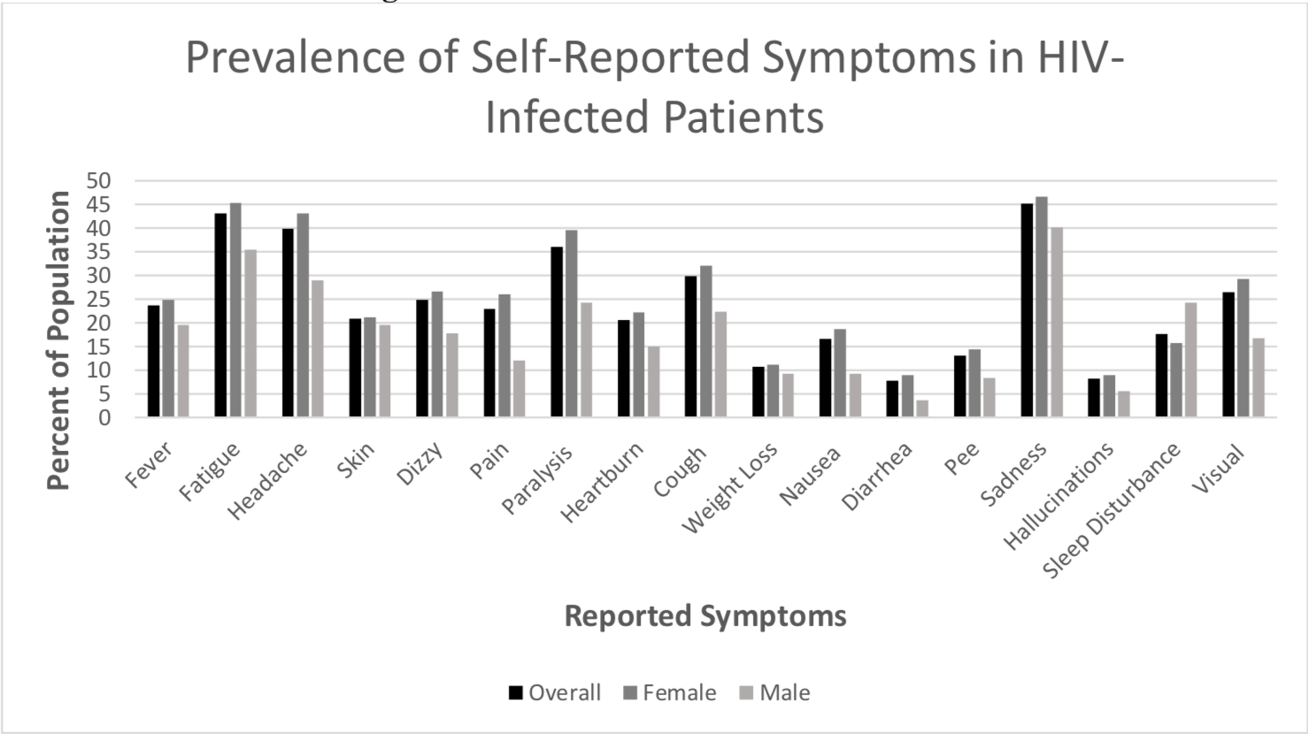
Does BASELINE CD4 Count PREDICT Symptoms Related to Mental Illness In HIV Infected Patients?
Christopher w. Bland, Dr. Juliet N. Sekandi, Advisor, Department of Epidemiology & Biostatistics
Background
Results
Discussion
Mental disorders have been reported to be common in people living with HIV/AIDS (1), with depression being the most prevalent seen in about 60% of people.
Screening for mental illness for HIV patients is rarely done in Africa due to limited resources
Mental illness has negative impacts on adherence to ART and results in poor treatment outcomes
Simple clinic-based tools for screening are needed to identify patients that could benefit targeted mental health testing and concurrent care
Results of this study could have important clinical and policy implications for low-resource settings .
Figure 1: Symptom Prevalence of 476 HIV-Infected Patients on Antiretroviral Therapy at a Public Clinic in Urban Uganda.
.
Symptoms of indicative of depression such as sadness and fatigue were relatively prevalent in the study population and were slightly more in female compared to male patients.
CD4 counts below 500 cell/ml were positively associated with higher scores for psychological symptoms commonly related to mental illness when controlling for age, sex and ART duration.
Conclusion
Objective
Although our results are not statistically significant, they may have clinical significance
Study results highlights that a combination of CD4 count and self-reported symptoms could provide a potentially useful tool for initial screening for mental illness in this setting
Therefore, we suggest that at the very least patients with CD4 count <500 cells/ml be given priority in screening for mental illness where it’s not a part of routine care for HIV patients.
To evaluate relationship between baseline CD4 count and self-reported symptoms of mental illness among HIV patients on anti-retroviral therapy (ART)
Methods
Cross-sectional study of 476 patients receiving HIV/AIDS care and ART from a public health clinic in Kampala, Uganda.
Socio-demographic and clinical characteristics such as ART initiation date and regimen, and self-reported symptoms were documented.
Exposure: baseline CD4 count was collected as a continuous variable and categorized into three levels. Level 1: 0-200 cells/ml, Level 2: 201-500 cells/ml, and Level 3: >500 cells.
Outcome variable: Psychological Symptoms combined fatigue, sadness, dizziness, paralysis, heartburn, weight loss, and sleep disturbances using factor analysis.
Linear mixed-effects regression model to estimate unadjusted and adjusted effects of baseline CD4 count on psychological symptoms measure.
Table 1: Results of Unadjusted and Adjusted Linear Regression Models of CD4 Levels and Psychological Symptoms
Unadjusted Adjusted
Public Health Implications
Mental disorders are increasingly contributing to the burden of disease and disability globally
Our new challenge as public health professionals is to identify simple low-cost but effective interventions to curtail the negative impact of mental illness and improve the quality of life in populations living with HIV infection.
*Reference category for CD4 count: >500 cell/ml
Acknowledgements: Dr. Juliet Sekandi, Henok Woldu
1. Yeneabat, T., Bedaso, A., & Amare, T. (2017). Factors associated with depressive symptoms in people living with HIV attending antiretroviral clinic at Fitche Zonal Hospital, Central Ethiopia: cross-sectional study conducted in 2012. Neuropsychiatric Disease and Treatment, 13, 2125–2131. http://doi.org/10.2147/NDT.S131722

