Slide 1
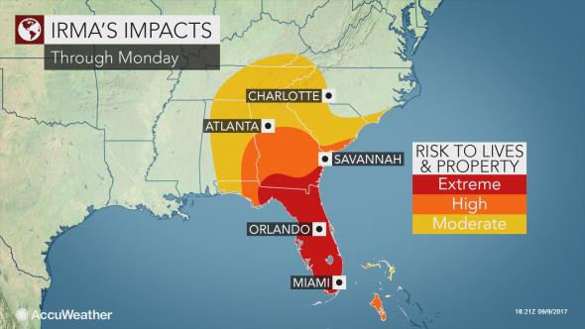
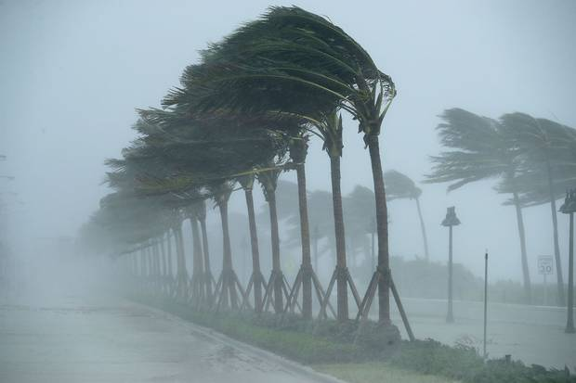
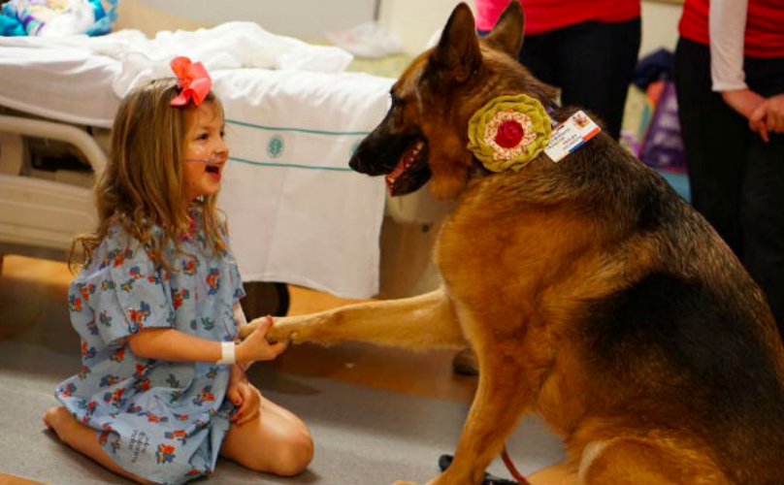
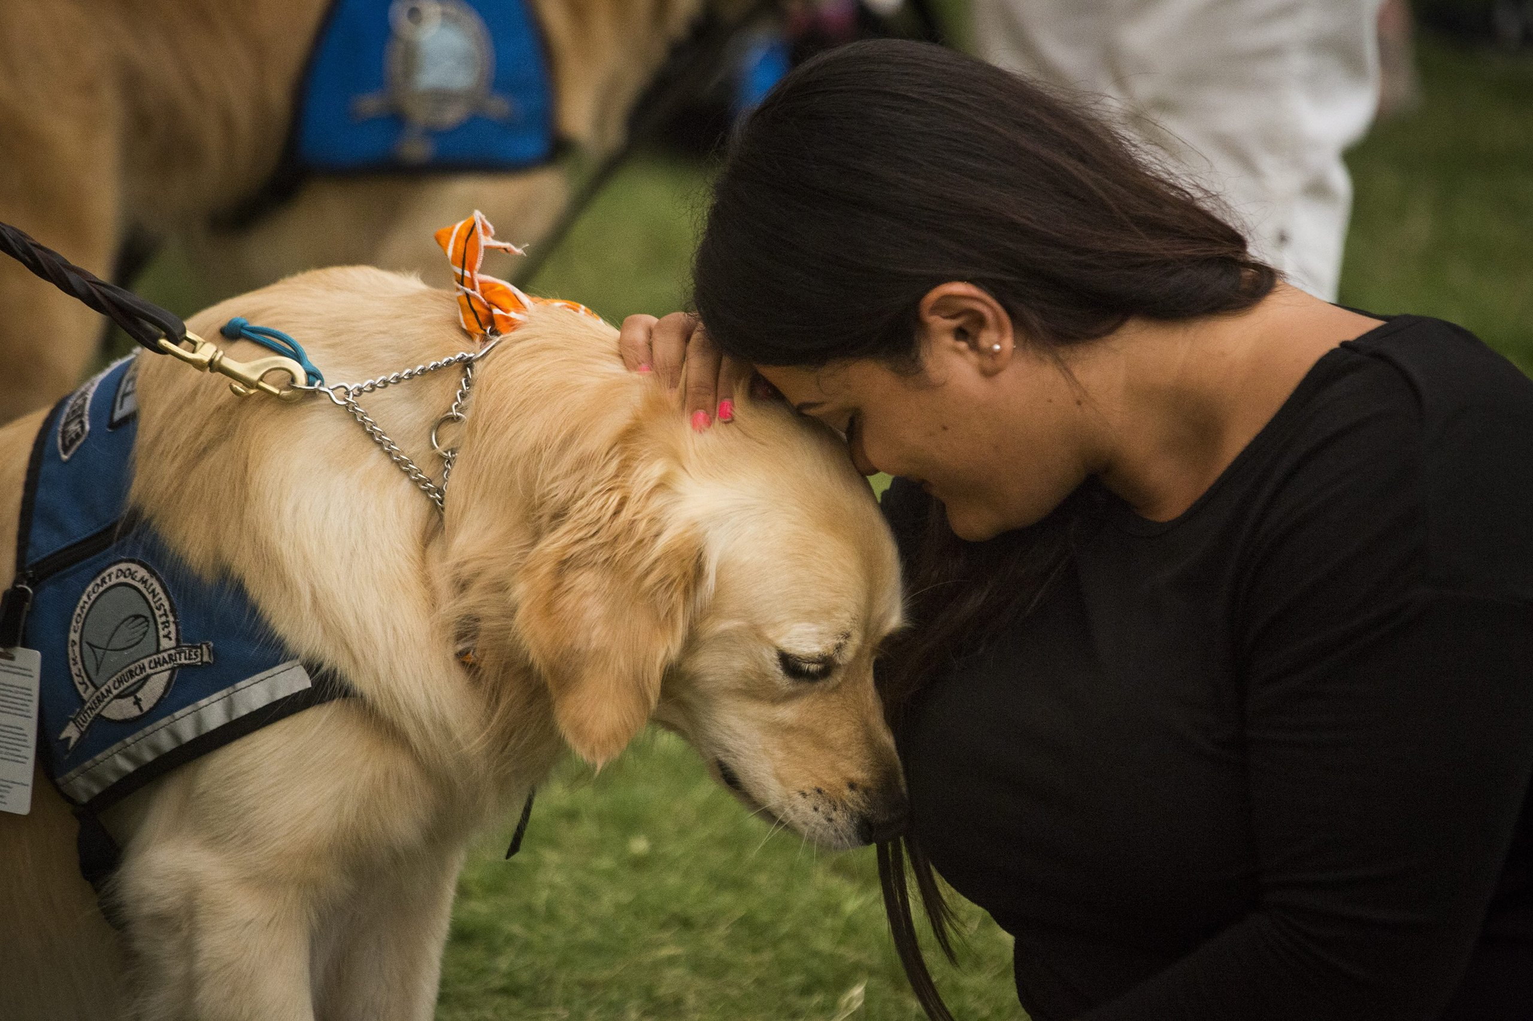
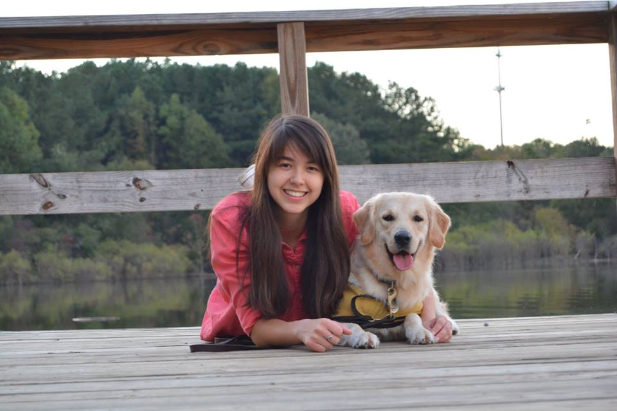
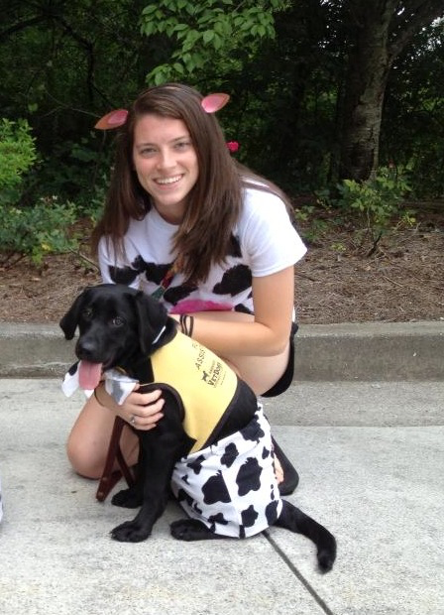
Disaster Preparedness Practices Among Puppy Raisers
The University of Georgia, College of Public Health
Institute for Disaster Management
Shelby Naar, Dr. Sarah DeYoung
According to the 2017-2018 American Pet Products Association (APPA) National Pet Owners Survey, 68% of households within the U.S. own a pet. (1)
In 1994, APPA calculated total U.S. pet industry expenditures to be $17 billion, and in 2016, that number soared to almost $67 billion. (1)
Research shows pet ownership affects cardiovascular health, increases physical activity, enhances the welfare of the elderly, and serves as a source of support for people experiencing crisis and hardship. (2)
Dogs, although popular pets, serve in many occupational roles, including guiding for the blind, search and rescue, assistance for those with disabilities, police detection, and medical detection work. (3)
Specifically, guide dogs for the blind have become common throughout the world with their origin tracing back to Germany after the end of World War I. (4)
Guide dogs (in training) live with a puppy raiser, get assigned to a trainer once old enough, and eventually matched with a person who is visually impaired.
College students are the most common group of puppy raiser volunteers because they are able to expose the dogs to many different environments. (5)
Many factors contribute to low or high risk perception among students, including optimistic bias, self-efficacy, perception of benefits, perceived severity, or fear. (6)
Students still rely on leaders for risk information such as parents, professors, and friends to help them find accurate information, parents being mentioned as the most common interpersonal source. (7)
Introduction
Methods
Results
SAS version 9.4 was used to code the survey responses, assess frequencies, and conduct chi-square analyses.
Certain survey answers with multiple or qualitative answers were either dichotomized or converted into categorical variables for ease of analysis in SAS.
The volunteer classification was dichotomized to be either ‘first time raiser’ or ‘repeat raiser,’ where repeat and past raisers were categorized as the latter and all others were categorized as first time raisers.
The question regarding evacuation location was categorized to be ‘relative’s house,’ ‘friend’s house,’ and all others that just listed a state or city as ‘location.’
Supplies prepared specifically for animals prior to Irma were also categorized based on themes, which included ‘food/water,’ ‘medical/first aid,’ ‘papers/records,’ and ‘rain/outdoor gear.’
Table 2. Distribution and chi-square analysis of puppy raiser classification and whether or not they considered evacuation prior to Irma, including odds ratio, 95% confidence interval, and p-value.
*OR: Odds Ratio, CI: Confidence Interval
Table 2 reflects that the odds of first time puppy raisers considering evacuation for Irma was 15.3 times the odds of repeat puppy raisers considering evacuation.
 | Irma Evacuation |  |  | Variable | OR* | 95% CI* | P-value
Raiser Type | Yes | No | Total | Raiser Type
First time | 8 | 6 | 14 | First time | 1.00 | - | -
Repeat | 2 | 23 | 25 | Repeat | 15.33 | ( , ) | 0.0007
Total | 10 | 29 | 39
Results
Out of the 58 participants who completed the survey, majority were female (n = 53, 91%) with a mean age of 28 years (SD = 14).
The respondents were predominantly white (n = 51, 88%), and the remaining respondents were Hispanic (n = 3, 5%), Asian (n = 2, 3%), and African American (n = 1, 2%).
Seniors made up most of the college students (n = 19, 48%), followed by graduate and dual-degree students (n = 9, 22%), juniors (n = 8, 20%), and sophomores (n = 4, 10%).
Among the puppy raisers, 65% of them were repeat raisers, meaning they had already raised one or more dogs, while 35% were first time raisers.
Table 1. Survey responses to “highest risk to self” and “highest risk to pet
*Due to this question being later in the survey, there are fewer responses
Among puppy raisers who said they had an evacuation plan for their GDF puppy, 59% (n = 17) stated they would just put the dog in the car with them and leave.
Only two raisers said anything about bringing a preparedness or disaster kit for their dog, and another two mentioned bringing papers and vaccine records.
For Athens residents, 33% (n = 33) stated they would go stay with family, 4% (n = 14) mentioned going to a friend’s place, and 29% (n = 14) just listed a location.
Family was also a popular response among college students when asked where they’d go if they had to evacuate their parents’ house (41%).
Of the 33 participants that prepared supplies specifically for their animal before Irma, 32 mentioned food and water, 4 gathered animal medical supplies, 5 mentioned outside gear for the dogs for potty breaks or a way for the dogs to do so inside, and a final 2 mentioned getting together papers or vaccine records.
Image sources: https://www.theglobeandmail.com/news/world/hurricane-irma-damage-explainer/article36225122/ and https://www.accuweather.com
Discussion
Over half of the puppy raisers did not have a disaster kit of any kind; many prepared food and water for their dog prior to Irma, but very few mentioned vaccine records or anything medical-related for the dog.
Not being able to find a pet-friendly hotel or pet-friendly shelter is a common reason for pet owners not wanting to evacuate, and not having vaccine records can likely exacerbate that issue. (8)
When asked about having an evacuation plan for their GDF dog, over half stated not having a plan at all, and among those that did have a plan, the majority just mentioned putting the dog in the car with them.
Few respondents mentioned vaccine records or a disaster kit, with only one participant stating they always kept a kit in the car for their dog.
This supports existing literature on preparedness among college students, with the most common preparedness activities found to be storing water or food, having a working flashlight, and taking a CPR class. (9)
Many college students mentioned evacuating to where their parents live and is important since students still tend to rely on parents for risk-related information more so than media or other interpersonal sources. (7)
In a similar way that students take few protective actions because they assume the university will take care of them in the event of a disaster, puppy raisers may expect the same from whatever organization they are volunteers for. (9)
These results can be used as a foundation in research for service dog organizations into hazard and disaster preparedness among their puppy raiser volunteers.
Existing leadership positions could incorporate potential preparedness protocols into their volunteer group meetings.
Service dog puppy raisers are a dynamic group of pet owners that are most likely not accounted for in many pet management plans, so it is important to practice individual and community-level preparedness.
Risk to Pet* |  |  | Risk to Self
Risk | Frequency | Percentage (%) | Risk | Frequency | Percentage (%)
Auto Accident | 32 | 74.4 | Auto Accident | 43 | 74.1
Canine Flu/Illness | 5 | 11.6 | Flu/Illness | 10 | 17.3
Severe Weather | 2 | 4.70 | Severe Weather | 1 | 1.70
Active Shooter | 1 | 2.30 | Active Shooter | 1 | 1.70
Structural Fire | 2 | 4.70 | Structural Fire | 0 | 0
Other | 1 | 2.30 | Sport/Physical Injury | 2 | 3.50
 |  |  | Other | 1 | 1.70
Image sources: https://barkpost.com/best-therapy-dog-breeds/ and https://www.usmagazine.com/celebrity-news/news/therapy-dogs-fly-to-orlando-to-comfort-survivors-w210240/
Methods
The purpose of this study was to explore the differences in preparedness and risk perception that occurred among puppy raiser volunteers through an online survey.
The survey was sent out on an email list serve of local puppy raisers as well as five other southeastern volunteer groups (~300 people).
The survey received a total of 84 responses. However, 26 of those respondents did not finish the survey, giving a complete sample size of n=58 (response rate = 19%).
Acknowledgements
This research was made possible through the instruction of Dr. Sarah DeYoung as well as the University of Georgia Institute for Disaster Management. I would also like to express my gratitude to Deana Izzo, the southeastern coordinator for the Guide Dog Foundation, for helping me spread the survey to the puppy raiser volunteers.
Sources: 1. http://www.americanpetproducts.org/press_industrytrends.asp. 2. https://doi.org/10.1606/1044-3894.2014.95.33. 3. https://www.telegraph.co.uk/pets/essentials/jobs-for-working-dogs/. 4. http://proxy-remote.galib.uga.edu/login?url=http://search.ebscohost.com/login.aspx?direct=true&db=edb&AN=108866018&site=eds-live. 5. https://www.redandblack.com/uganews/dawgs-training-dogs-guide-dog-training-from-start-to-finish/article_b855aebc-1420-11e7-960e-5b0f5b880e8e.html. 6. https://doi.org/10.1007/s12119-016-9380-z. 7. http://proxy-remote.galib.uga.edu/login?url=http://search.ebscohost.com/. 8. http://proxy-remote.galib.uga.edu/login?url=http://search.ebscohost.com. 9. http://proxy-remote.galib.uga.edu/login?url=http://search.ebscohost.com

