Slide 1
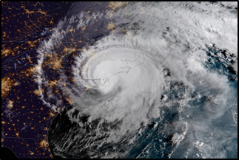
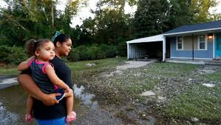
Pregnancy, stress and social support during Hurricane Florence
Victoria Jackson| Sarah DeYoung,PhD | Health Promotion and Behavior | May 1th, 2019
BACKGROUND
METHODS
RESULTS
From 2016 to 2018 there were a total of 15 Hurricanes that hit the United States. Last year Hurricane Florence impacted families and each year natural disasters affect many populations. Often the burden of the evacuations creates stress for the affected populations. However, few studies have examined the effects of natural disasters on maternal and caretaker health. This study examines the effect of a hurricane on the experience of caregivers, specifically with regards to stress and social support and the effect of a hurricane on the experience of pregnancy and birthing.
This is a cross-sectional study using volunteer and snowball sampling through social media and using Facebook groups from Virginia, North Carolina, South Carolina – the geographic areas most severely impacted by Hurricane Florence. The quantitative data includes measures of stress, social, support, evacuation status, and demographic variables. The qualitative data includes open-ended responses about preparedness and respondent perceptions of Hurricane Florence.
A total of 115 respondents completed the survey from the ages of 18 to 62 years of age. The respondents were from North Carolina 73.5 %, 1.5% were from South Carolina, 1.5% were from Virginia, and 6.8% were from other locations. We conducted reliability analyses on the scales of social support and the cronbach’s alpha for this scale was α = .80. Results from chi-squares compared the proportion of respondents who reported having support for a financial emergency were significant χ2 = 16.43 (1), p <.001, specifically that higher income respondents indicated the ability to rely on someone in case of an emergency. Finally, a regression analysis indicated that there was a negative relationship between social support overall stress as a dependent variable, while evacuation status and pregnancy status were not significant predictors of stress.

Slide 2
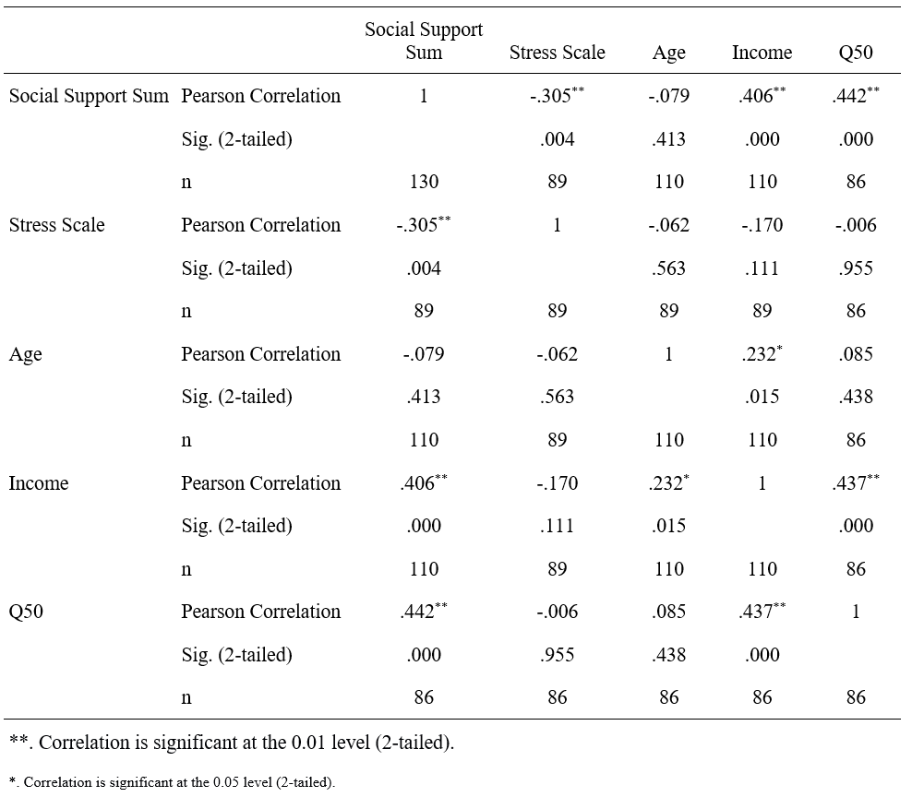
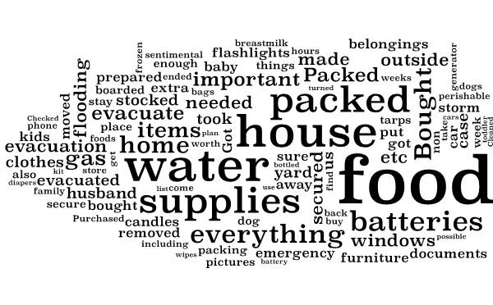
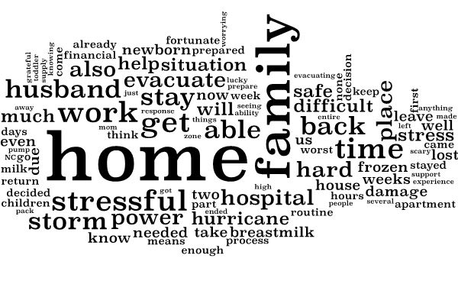
The Impact Hurricane Florence on Caregivers and Pregnancy
Victoria Jackson| Sarah DeYoung,PhD | Health Promotion and Behavior | May 1th, 2019
DATA & GRAPHICS
IMPLICATIONS
The results of this study provide a foundation for identifying factors that influence caregiver stress during hazards. It is essential to take the findings from this study as well as lessons learned from other natural disasters to improve the emergency preparedness for caregivers and pregnant women. When a disaster happens there is a disaster plan that is created there should be a policy that requires a plan for mothers, infants and children. This why when they do find women who are in labor or pregnant or caregivers with infants there can be a plan on how to combat the situations. The local WIC office should also have an emergency staff that is there to aide. The WIC office has contact information for the families they serve and when a natural disaster occurs, they should attempt to reach out to each one of those families to assess their needs. This will also help provide accurate information for what is needed when people ask how they can help. In the event there are shelters for the victims it should be required to have doulas, midwives and obstetrician/gynecologist on staff at all times.

