Slide 1
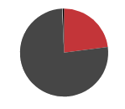
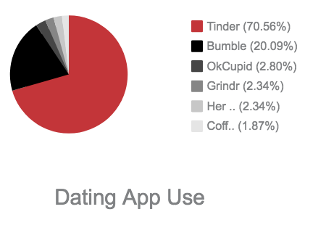
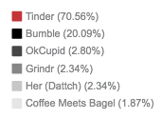
Outcomes of “Swiping Right”: Sexual Risk Behaviors of Undergraduate Tinder Users
Alexis Whitmire | Dr. Carolyn Lauckner | Health Promotion & Behavior | Spring 2019
INTRODUCTION & STUDY AIMS
DATA & GRAPHICS
RESULTS
College students (aged 18-24) are more likely to be sexually risky than older populations. Undergraduates are more likely to have more sexual partners, use condoms less consistently, and are tested for sexually transmitted diseases (STDs) less than other groups.^{1,2}
College aged adults also make up the largest user group of dating applications, such as Tinder, Grindr, Bumble and OkCupid.
Sexual risk behaviors are higher in dating app users, specifically Tinder users.³
With young adults making up a large portion of dating app users and and a recent rise in STDs among this population, understanding this relationship is important.
This study examined the sexual risk outcomes of Tinder users, the most popular dating app among a sample of undergraduates, in comparison to non-Tinder users.
The aim of this study was to assess the relationship between a specific dating app and sexual risk outcomes such as condom use, STD testing and diagnosis, and number of partners.
The results of this research can be used to inform future sexual health interventions targeting undergraduates who use dating apps.
Sexual Behaviors
All participants had engaged in vaginal, oral, or anal sex
The average number of sexual partners was 1.61 (SD=1.5)
Birth control pills were most common form of contraception (53%) followed by condoms (50%). 25% selected both condoms and pills.
Dating App Use and Sexual Risk
36.6% reported ever using a dating app. The most popular dating app was Tinder with 98% reporting current or past use.
66.2% reported meeting someone in person from an app and 73% reported having sex with a partner they had met on a dating app.
Tinder Users vs Non-Tinder Users
Tinder users were less likely to “always” use a condom compared to non-Tinder users (𝜒²(3)=12.74, p=.005).
Tinder users were also less likely to be tested for an STD than non-Tinder users (𝜒²(1)=14.86, p<.001).
While less likely to be tested for an STD, Tinder users were not more likely to be diagnosed with an STD.
Tinder users also reported having more sexual partners in the previous 3 months (M=2.01, SD=2.02) than non-Tinder users (M=1.39, SD=1.14); t(422)=4.006, p<.001.
METHODS
DISCUSSION
A cross-sectional online survey was distributed to undergraduates from two southeastern universities. Participants were recruited through in class announcements, emails, listservs, and an undergraduate research participation pool for psychology majors.
The convenience sample consisted of 424 sexually active (defined as ever having vaginal, oral, or anal sex) students between 18-30 years old. The mean age of the sample was 20 years old (SD=1.8)
Participants answered 225 questions total. Items used for analysis included dating app use, number of sexual partners, contraceptive use, STD testing and diagnosis, relationship status and demographics.
Chi-square tests were done for condom use, STD testing, and diagnosis. An independent samples t-test was used for number of sexual partners. Descriptive statistics were used to analyze demographic and dating app use data.
Previous studies indicate that Tinder users may be more predisposed to sexual risk than those who do not use the app.⁴ With findings to show that Tinder users among our sample are at increased risk for STDs and unintended pregnancy, this may be a beneficial avenue for health promotion interventions. Previous interventions for men who have sex with men using the dating app Grindr have found success, indicating that it may be beneficial to use Tinder for interventions to decrease sexual risk among heterosexual young adults.
REFERENCES
1. CDC. The State of STDs in 2017 | CDC. Centers for Disease Control and Prevention. https://www.cdc.gov/std/stats17/infographic.htm. Published 2018. Updated 2019-01-11T08:59:09Z/. Accessed2019
2. Patrick ME, O’Malley PM, Johnston LD, Terry-McElrath YM, Schulenberg JE. HIV/AIDS risk behaviors and substance use by young adults in the United States. Prevention Science. 2012;13(5):532-538.
3. Hashemi T. Main Findings - Social Media Demographics 2018 — We are Flint. We Are Flint. https://weareflint.co.uk/main-findings-social-media-demographics-uk-usa-2018. Published 2018. Accessed2019.
4. Timmermans E, De CaluwAaAaAeA E. To Tinder or not to Tinder, that's the question: An individual differences perspective to Tinder use and motives. Personality and Individual Differences. 2017.

